Slide 1
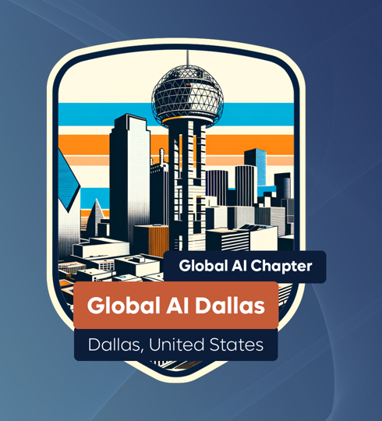
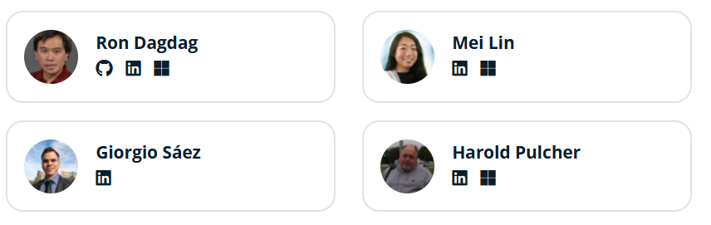
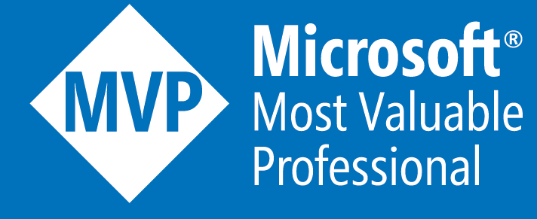

AI Community Day Dallas: Showcasing Innovation and Expertise in Artificial Intelligence
Connecting experts through AI innovation and collaboration
Notes:
AI-generated content may be incorrect. ---

Slide 2
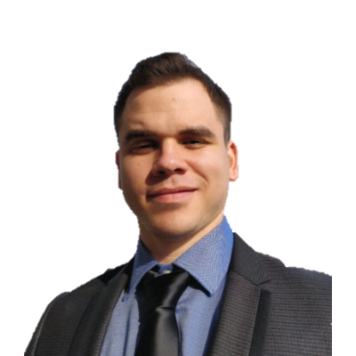
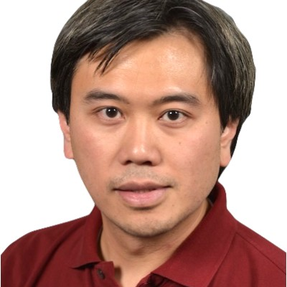

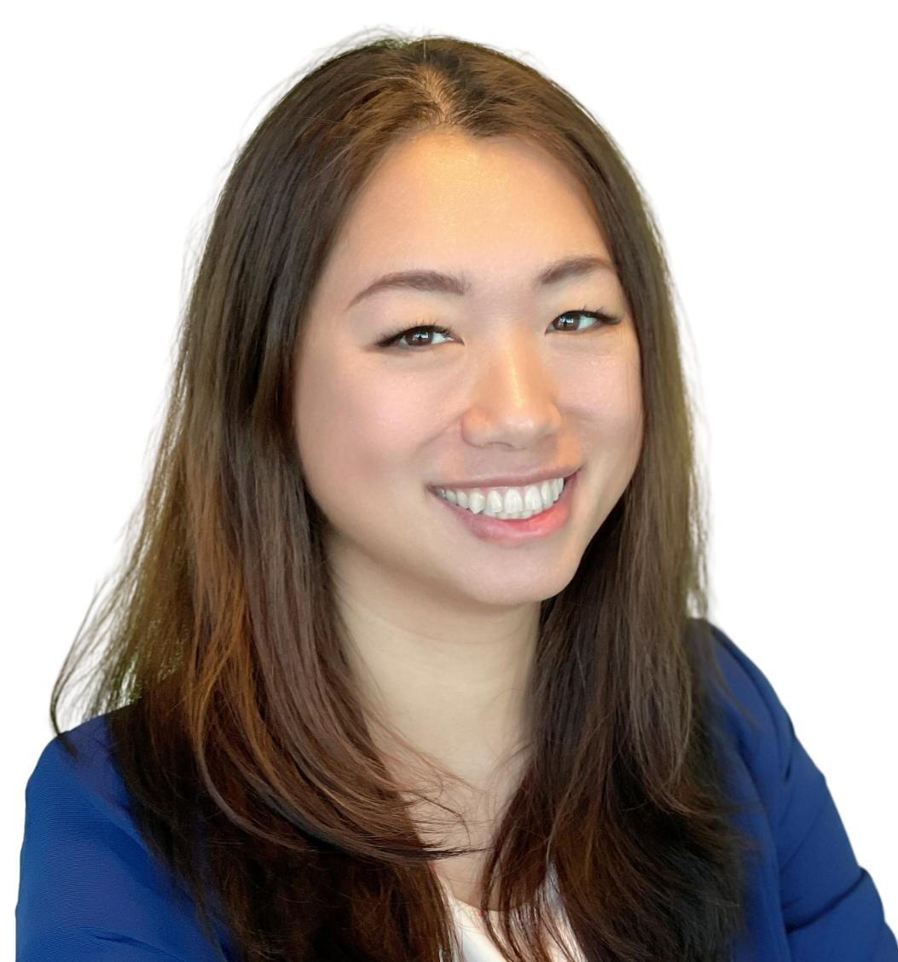



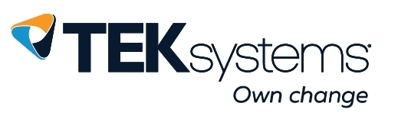
Event Agenda
Opening Remark
4 Sessions before Lunch
LUNCH
2 sessions after lunch
Hiring in the AI Era: Trends, Tips & Talent
Closing Remark

Slide 3
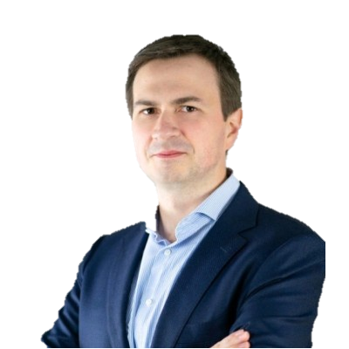
Driving AI Forward in DFW
Bart Slowik
Notes:
Bart Slowik: Exploring Azure Foundry Models, Jason Andrews: Extracting Data Insights From Documents, Images, Audio, and Video, Ron Dagdag: Designing Smarter Power Apps Solutions, Ashley Steiner: Tools in Your AI's Toolbox – An Introduction to MCP Servers, TRayburn: Integration Everywhere – Supercharge Your AI Agents with Custom Connectors, Eric Shupps: Innovating with AI in the Dallas-Fort Worth Community

Slide 4
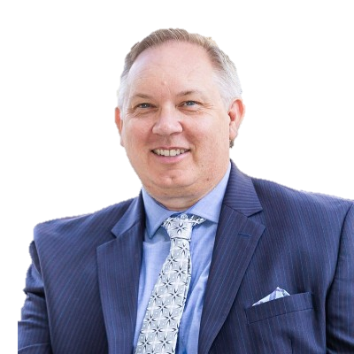
Extracting Data Insights From Documents, Images, Audio, and Video
Jason Andrews
Notes:
--- Extracting insights from unstructured data such as documents, images, audio, and video is a rapidly evolving domain powered by advancements in natural language processing, computer vision, and audio analytics. Techniques like Optical Character Recognition (OCR), image recognition, speech-to-text conversions, and sentiment analysis allow enterprises to convert raw multimedia data into actionable intelligence. According to recent industry studies, organizations leveraging multimodal AI have reported productivity gains of over 30% in information processing tasks. In the Dallas-Fort Worth region, sectors such as healthcare, legal, and media are actively adopting these technologies to improve decision-making and customer engagement. Image source: AI-generated

Slide 5

Designing Smarter Power Apps Solutions
Ron Dagdag
Notes:
--- Power Apps empowers citizen developers to create custom business applications with minimal code, significantly reducing development time and costs. The integration of AI components—such as AI Builder in Power Apps—enables smarter decision-making and automation via AI-driven data predictions, object detection, form processing, and language understanding. Real-world case studies indicate that organizations utilizing smarter Power Apps solutions have decreased process cycle times by up to 40%. Locally, Dallas enterprises leverage these apps to streamline workflows, improve customer experiences, and foster innovation within traditionally non-technical teams. Image source: AI-generated

Slide 6
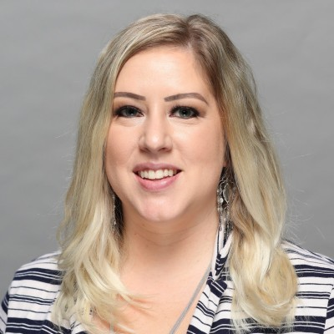
Tools in Your AI's Toolbox – An Introduction to MCP Servers
Ashley Steiner
Notes:
--- Microsoft Certified Partner (MCP) servers provide robust infrastructure for hosting and deploying AI models and applications, ensuring high availability, scalability, and security. These servers support diverse use cases, including edge AI deployment, private cloud AI hosting, and hybrid environments. Their optimized hardware and software ecosystems facilitate accelerated AI workloads and model inferencing. In Dallas-Fort Worth, MCP servers have been instrumental in supporting AI innovation across startups and enterprises alike, reducing latency and increasing throughput in AI-powered applications. Image source: AI-generated

Slide 7

Thank you for our community sponsor
And co-lead of Global AI community
Harold Pulcher

Slide 8
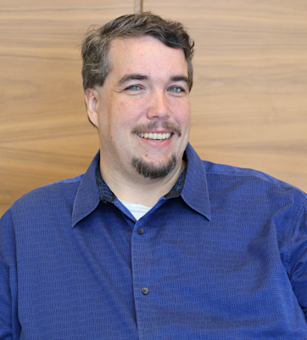
Integration Everywhere – Supercharge Your AI Agents with Custom Connectors
Tim Rayburn
Notes:
--- Custom connectors expand the capabilities of AI agents by enabling seamless integration with a wide range of third-party services and data sources, facilitating end-to-end automation and personalized user experiences. By leveraging these connectors, developers can extend AI agents beyond default functionalities to interact with legacy systems, specialized APIs, and proprietary databases. This flexibility has led to increased adoption of AI agents in sectors such as finance, manufacturing, and retail within the Dallas-Fort Worth metroplex. Recent data indicates businesses employing custom connectors observe an average 25% improvement in operational efficiency. Image source: AI-generated

Slide 9
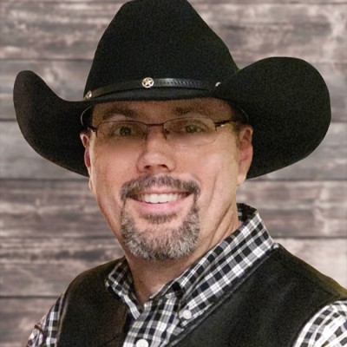
Innovating with AI in the Dallas-Fort Worth Community
Eric Shupps
Notes:
--- Dallas-Fort Worth’s AI ecosystem is vibrant and rapidly growing, supported by a combination of academic institutions, corporate innovation labs, and community initiatives. Eric Shupps has played a key role in driving AI adoption through mentorship, workshops, and collaborative projects that foster innovation across sectors such as healthcare, smart cities, and logistics. The region’s AI talent pool has expanded over 20% year-over-year, with strong industry-academic partnerships fueling workforce development. Community-led AI events and hackathons further engage professionals and enthusiasts, accelerating AI-driven economic growth in the metro area. Image source: AI-generated

Slide 10
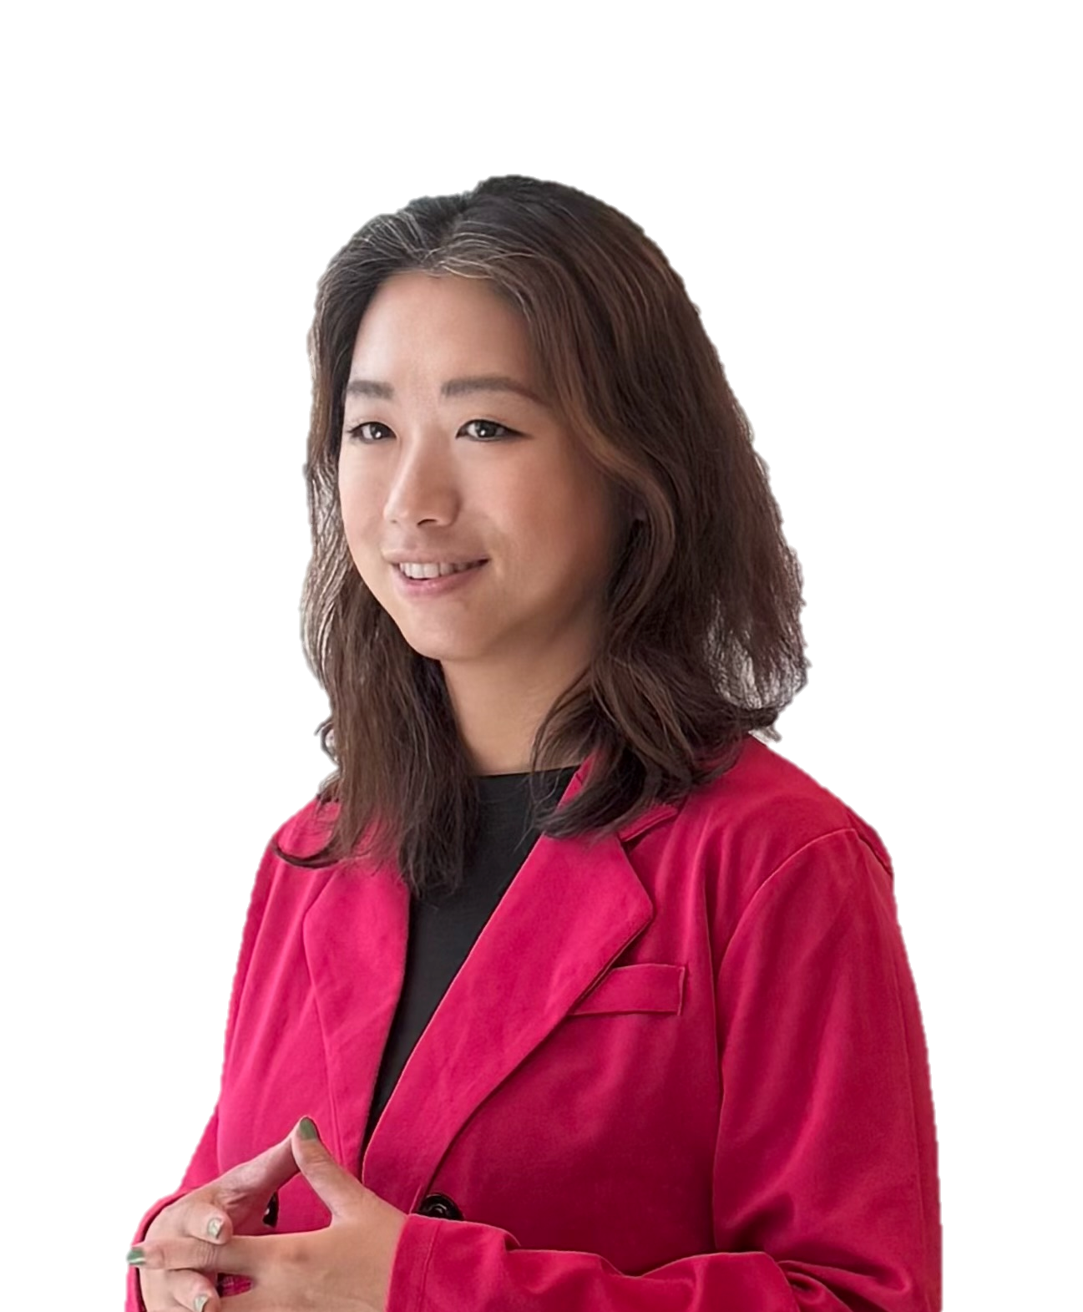
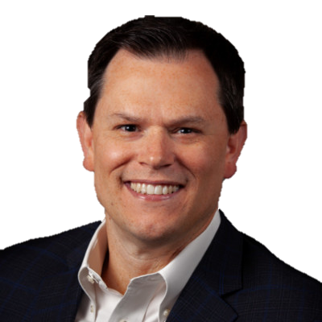
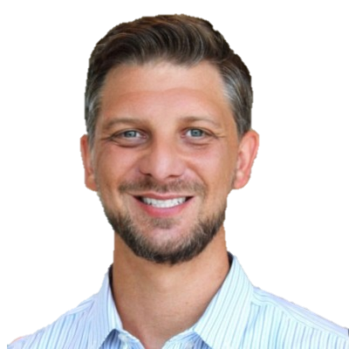
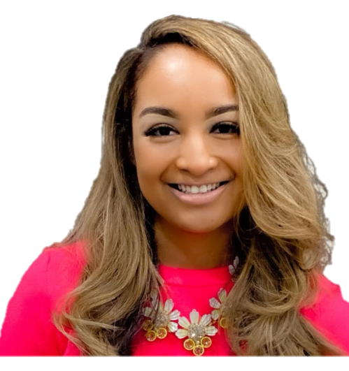
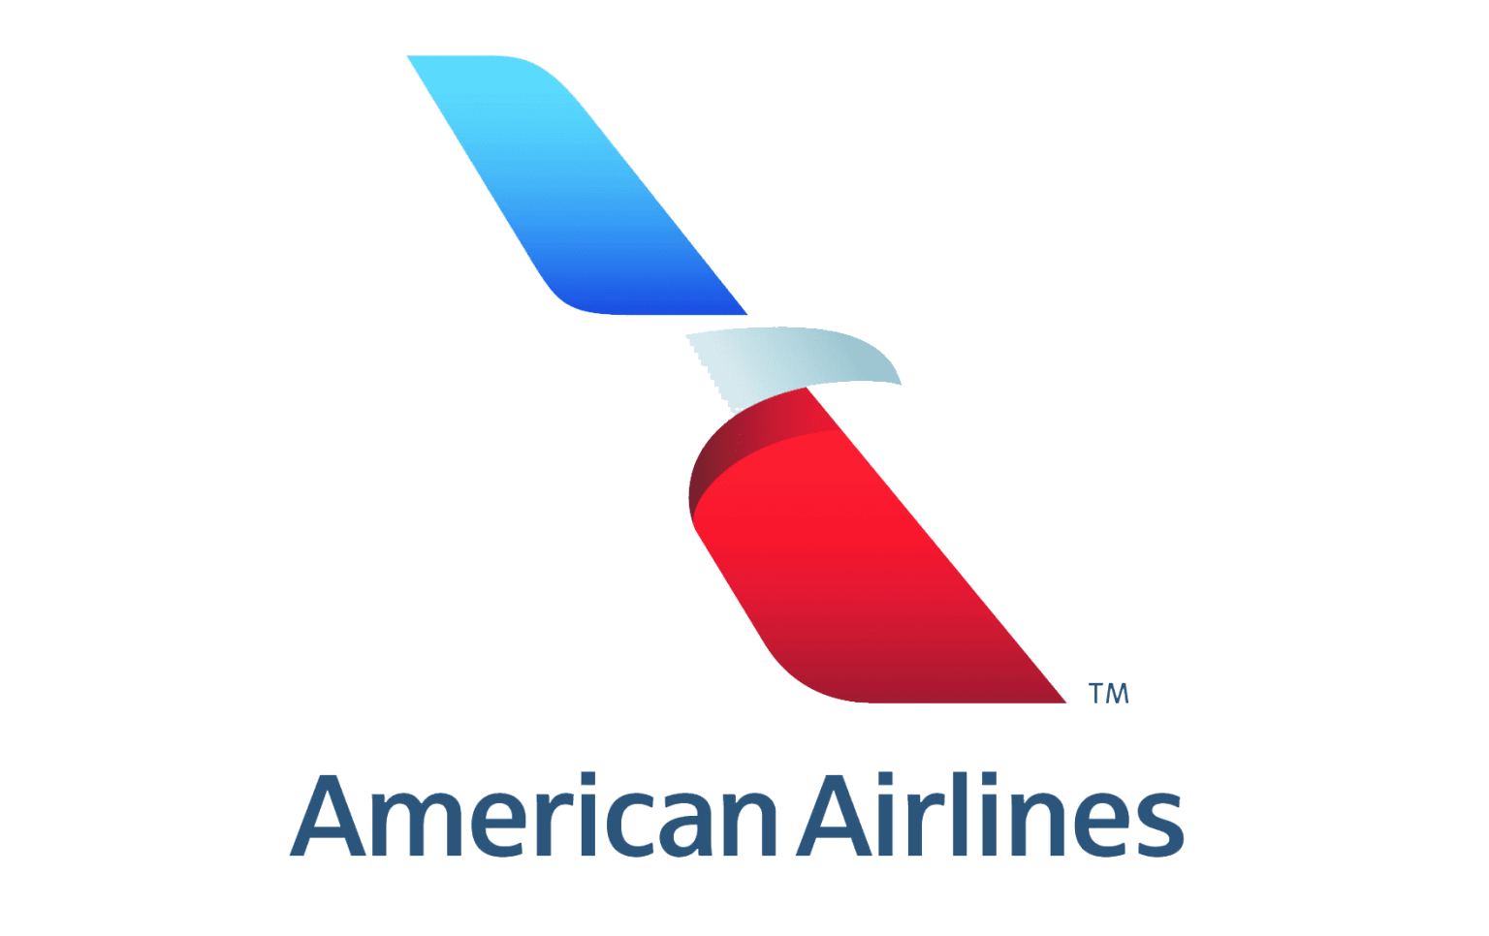

David Powell
Priscilla (P) Brock
Anderson (AJ) Smith
Mei Lin
Director, App Innovation
Sr. HR Manager
Tech Product Manager - Talent Acquis
Innov Strategist

Slide 11
Empowering Innovation Through Community
Notes:
AI-generated content may be incorrect. ---

